Slide 1




Slide 2
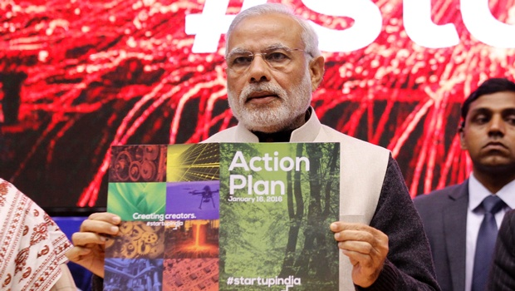
“Startup India Hub will be a single point of contact for the entire ecosystem and enable knowledge exchange and access to funding”
– Startup India Action Plan , Jan 2016
CONSOLIDATE THE CURRENT ECOSYSTEM | Bring all stakeholders to a common platform
 | Value proposition for all stakeholders
GROW THE ECOSYSTEM | Connect with global ecosystem
 | Stimulate others to join the ecosystem
FACILITATE STAKEHOLDERS | Access to information and knowledge
 | Handholding support
Launched by
Shri Narendra Modi
Hon’ble Prime Minister of India
16th January 2016

Slide 3
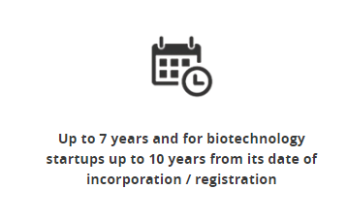
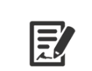
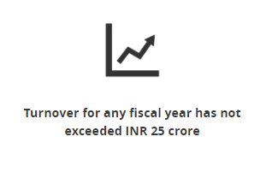
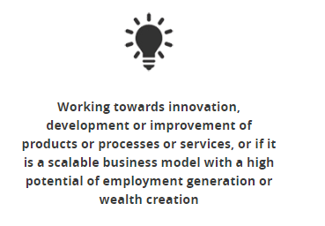
How to Define a startup?
Government of India Definition
AGE
ENTITY TYPE
TURNOVER
NATURE OF
INNOVATION
7 years from date of incorporation
(10 yrs for biotech)
Pvt. Ltd. Company or
LLP or
Partnership Firm
Must not exceed
INR 25 Cr. in in any fiscal year
Developing new or improving existing product/service offering

Slide 4
Recognition Procedure
Government of India Recognition
ONLINE APPLICATION FORM
UPLOAD SUPPORTING DOCUMENTS
APPLICATION EVALUATION
RECOGNITION AS STARTUP
15 – 20 minutes
24 - 48 hrs
Submit details on Startupindia.gov.in
Founder & Team Details
Entity Details
Business model
IP details
Startup India Team evaluates proposal and takes action within 24 - 48 hrs of
If suitable, then application approved,
If answers are not suitable, then second chance given to startups to reapply

Slide 5
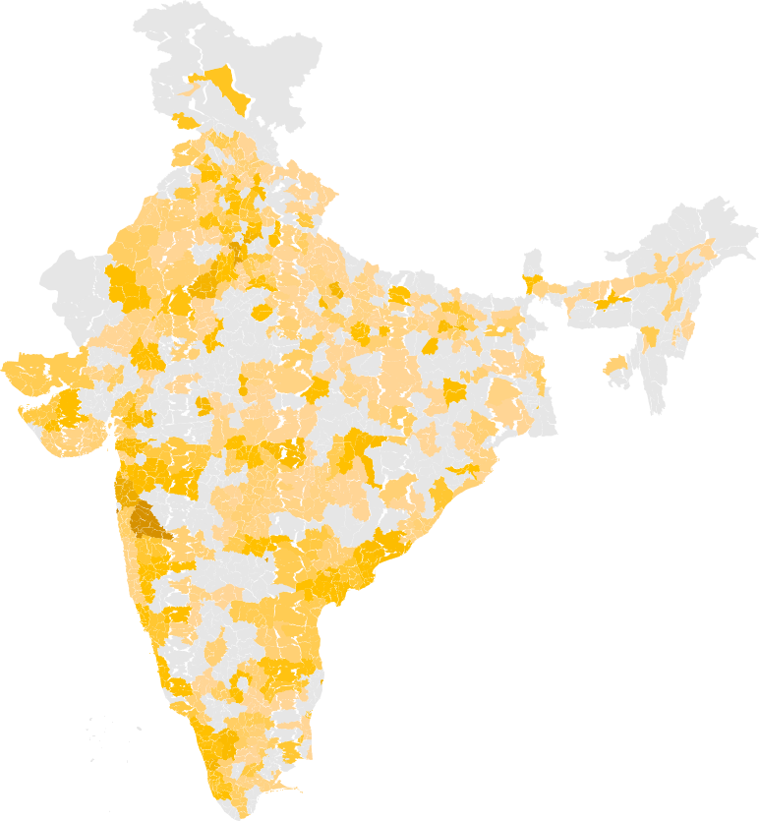
Startup India
Starting a startup revolution
STARTUP INDIA RECOGNITION
0
400
800
NO. OF STARTUPS RECOGNIZED
11,634
Startups Recognized with the Government of India
448
Districts
29
States
6
Union Territories
56%
Tier 1 Cities
27%
Tier 2 Cities
17%
Tier 3 Cities

Slide 6



Nation of Job Creators
Shaping a New India
12 Jobs
per startup*
*1,06,618 JOBS REPORTED BY 9,091
STARTUP INDIA RECOGNISED STARTUPS
DISTRIBUTION OF STARTUPS WITH ATLEAST 1 OR MORE WOMEN DIRECTOR (S)

Slide 7





Process simplification
Encouraging startups
Government Procurement
Patent
Granted
Tax
Benefit
Compliance
Regime
Faster
Exit
2018
Fast Track Examination
Income Tax Exemption
Self
Certification
Exempted
90 Days
2014
Experience, Turnover, EMD
required
Time Consuming Process
Nil
Physical Inspection
> 4 years

Slide 8
Funding Innovation
Fund of Funds
₹ 10,000 Cr. corpus to be provided by Mar’25
DIPP
SIDBI
27 VCFs
142 Startups
₹ 2,200 Cr. Authorised
₹ 1,285.7 Cr.
committed
₹ 180 Cr.
disbursed
Catalyze investment of ₹ 600 Cr.
Government Contribution Catalysing 10X Funds for Startups
₹1,285.7 Cr.
₹ 7,036 Cr.
₹ 13,888 Cr.
Government
Commitment
Corpus made
available to startups
Target Corpus to be made
available to startups

Slide 9

Startup India
Benefits for startups
Relaxation of Public Procurement Norms
Relaxation of turnover, experience, & EMD condition for startups
All Central Public Sector Undertakings to follow procedures and give preferential treatment to startups
DIPP Recognised startups can directly register and sell on Government-e-marketplace (GeM) with no requirement of turnover & experience criteria

Slide 10
Startup India
Benefits for startups
Patent & Trademark Benefits
80% rebate in patent filing fees
50% rebate in trademark filing fees
Empanelled 1,019 facilitators for free of cost filing & facilitation
Government to reimburse facilitators’ cost
801 applications have received 80% patent rebate
1,226 applications have received 50% trademark rebate

Slide 11

Startup India
Benefits for startups
Facilitation & Handholding
Dedicated facilitation support team at Invest India to handhold startups
48 hr response time for any startup enquiry made via email, twitter, or call centre
1,05,230 enquiries have been successfully resolved so far
547 startups mentored and facilitated by team (such as business advisory, financial advisory, tax & legal support, stakeholder introduction etc.)

Slide 12

Startup India
Benefits for startups
Easier Compliances
Inspections against 6 labour & 3 environmental laws relaxed for startups
Startups now allowed to self certify against laws; easing compliances for startups
Insolvency & Bankruptcy board constituted for fast track exit
90 day period for winding up operations as opposed to 4 yrs earlier

Slide 13


Startup India
Benefits for startups
Tax Exemptions
Tax exemption on investment from investor against issue of share capital and on profits and gains from income for 3 years
Startups can apply to avail exemption under Section 56 and Section 80 IAC of the Income Tax Act, 1961
Operating Guidelines Formulated
Evaluation Criteria
Inter Ministerial Board
Innovation & Uniqueness
Share Capital details
Merchant banker report
Details of Issue of Shares
Investor Details
DIPP
DBT
DST
MeitY
CBDT
SEBI
RBI
MCA

Slide 14

Funding Innovation
Building Capacities
INNOVATORS
Atal Tinkering Labs ₹ 488 cr.
Scheme run by NITI Aayog to set up tinkering labs in schools across India where young minds can give shape to their ideas through hands-on, do-it-yourself learning
2441 schools across India have been selected to setup tinkering labs
Grant-in-aid of INR 20 Lakhs per lab over a period of 5 years

Slide 15
Funding Innovation
Building Capacities
INNOVATORS
MANAK ₹ 30 cr.
Scheme run by Dept. of Science & Technology to strengthen science and technology system, increase R&D human resource base by inviting students from all government and private schools to send their original and creative technological ideas/innovations.
30,678 students received a grant of INR 10,000 each

Slide 16
Funding Innovation
Building Capacities
INNOVATORS
Uchhattar Avishkar Yojana ₹ 258 cr.
Scheme run by Min. of Human Resource Development to jointly fund research projects, along with private entities, undertaken by IIT students
Funding support provided to 85 research projects at various IITs, for product development & commercialization

Slide 17
Funding Innovation
Building Capacities
INFRASTRUCTURE
Incubation Centres ₹ 244 cr.
Supporting creating of world class incubation facilities across India that will enable entrepreneurs by mentoring and cultivating their ideas into successful ventures
NITI AAYOG
Dept. of Science & Technology
Dept. of Biotechnology

Slide 18
Funding Innovation
Building Capacities
INFRASTRUCTURE
Research Parks ₹ 665 cr.
Scheme run by Min. of Human Resource Development to setting up research facilities for incubation and joint Research and Development (R&D) efforts between academia and industry
Establishment of R&D facilities across 7 IITs & IISc Bangalore ( i.e. academia-industry collaboration)

Slide 19
Funding Innovation
Building Capacities
INFRASTRUCTURE
Bio Clusters & Regional Centres₹ 412 cr.
Spearheaded by Dept. of Biotechnology to promote innovation among Biotech companies and support commercialization of research
4 bio-clusters at Kalyani, Bangalore, Faridabad & Pune
3 BIRAC Regional Centres at Hyderabad, Bangalore & Pune

Slide 20


Startup India Online Hub
India’s Largest Virtual Incubation Platform
www.startupindiahub.org.in
Information Discovery
Curated Learning Programs
Discover, Connect, & Engage with Ecosystem Stakeholders
Networking & Engagement
Tools & Templates
Applications to enablers

Slide 21

Startup India Learning Program
4 weeks long || Free of Cost || English & Hindi
Course Content
Startup India Learning Program
Idea Assessment
Building a Legal Foundation
Finance Basics
Additional Resources
Business Planning
Discussion forums
Online workshops
Templates/ Resources
Fundraising & Valuation
Business Plan

Slide 22



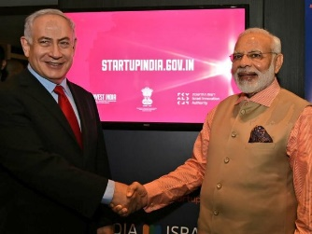


Building International Bridges
Market Entry for Indian Startups
Objectives
International bridges for cross border exchange of startups
Market entry support for Indian startups looking to expand to other countries
Connecting Indian startups with local stakeholders for successful expansion
Successful Examples of Startup India International Partnerships
Portugal
Israel
Sweden
Singapore

Slide 23

State
Startup Initiatives

Slide 24
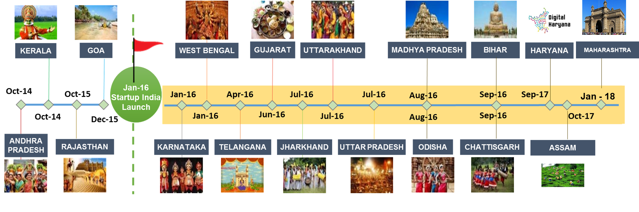
18 States with Startup Policies
14 Launched After Startup India

Slide 25
State Startup Ranking Framework
Objectives
Compendium of 112 good practices launched
Highlight achievements made by State Govts.
Foster Competitiveness amongst State Govts.
Recognised State Government
Facilitate learning of best practices
Knowledge exchange workshop at leading incubators
Notes:
1. Compendium of good practices
2.A Ranking
2.B Awards & recognition to states & officers
3. 2 day knowledge exchange workshops at 3 leading incubators

Slide 26
State Startup Ranking Framework
Overview of Framework
Startup Policy & Implementation
1
Incubation Support
2
Seed Funding Support
7 Areas of Intervention
----------------
38 Action
Points
3
Angel & Venture Funding Support
4
Simplified Regulations
5
Easing Public Procurement
6
Awareness & Outreach
7

Slide 27
Best Practices
Compendium of 112 Practices Across 38 Action Points
Pillars of Implementations
Online platform to self certify compliance under Labour Laws (Rajasthan)
Roundtable with major e-pharmacy startups, state govts. & DGCI (GOI)
Incubation Support
Launched T-Hub; 70,000 sq. ft. Incubation area (Telangana)
iCreate; 40 acre campus to promote startups (Gujarat)
Seed Funding
Seed Capital Fund Scheme providing funding of up to INR 7.5 lakhs (Jammu & Kashmir)
Grant of upto INR 10 lakhs as an interest free loan for 10 yrs. (Bihar)
Angel & VC Funding
Facilitate set up of Angel Investor Network (Odisha)
INR 500 Cr. Fund of Funds set up (Kerala)

Slide 28
Best Practices
Compendium of 112 Practices Across 38 Action Points
Simplified Regulations
Innovation Society (Andhra Pradesh)
Startup Council under Hon’ble CM (Karnataka)
Public Procurement
Credential Development Assistance up to 10% (Madhya Pradesh)
Special provision of 20% total procurement from Startups (Odisha)
Awareness & Outreach
Startup India Yatra series in search of entrepreneurial talent from tier 2 & 3 cities (GOI)
Bootcamps across all 27 districts; 3,858 ideas (Chhattisgarh)

Slide 29

Startup India Yatra

Slide 30
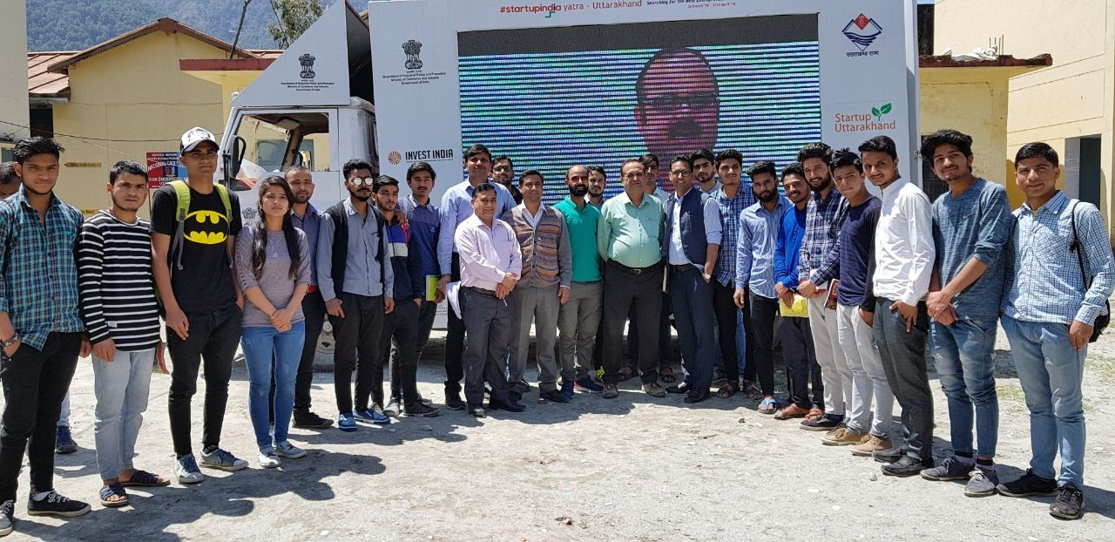
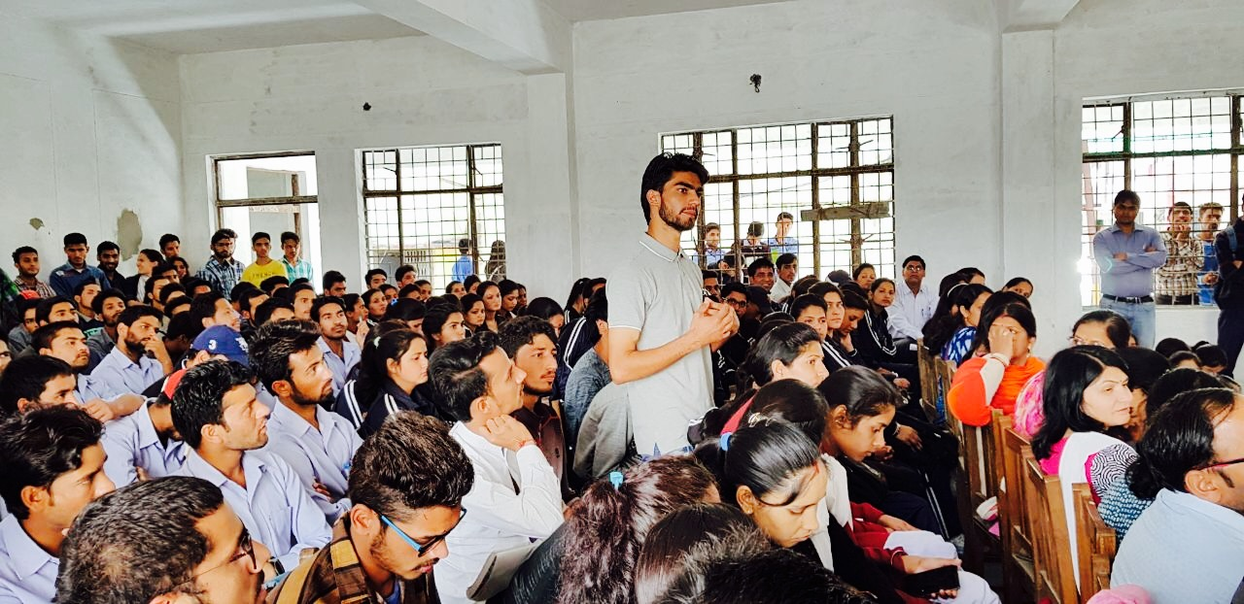
Startup India Yatra
Creating Entrepreneurs in Tier 2/3 Cities of India
Offline initiative to promote & support grassroot
innovation coming from tier 2 & 3 cities
Conducted across local colleges & universities
Day long mentorship workshops taken by experts
Idea submission at each session
Outcomes
Grand Finale for incubation opportunity at India’s leading centres
Potential cash prize funded by State Government

Slide 31
Startup India Yatra
Outcomes so far…
Uttar
Pradesh
Odisha
Gujarat
Uttarakhand
Madhya
Pradesh
7 Districts
10 Districts
5 Districts
13 Districts
14 Districts
5,000+
Individuals
10,000+
Individuals
3,000+
Individuals
3,000+
Individuals
4,000+
Individuals
44
Incubation Offers
76
Incubation Offers
22
Incubation Offers
10
Incubation Offers
110
Incubation Offers

Slide 32




Key Officials
Ramesh Abhishek
Secretary, DIPP
secy-ipp@nic.in
Atul Chaturvedi
Additional Secretary, DIPP
atul.chaturvedi@nic.in
Anil Agrawal
Joint Secretary, DIPP
agrawal.anil@gov.in
Shruti Singh
Director, DIPP
singh.shruti@gov.in
Suyash Mishra
Asst. Vice President, Invest India
suyash.mishra@investindia.org.in
Connect With Us
www.startupindia.gov.in
1800-11-5565
dipp-startups@nic.in
@startupindia
Startup India

